Slide 1
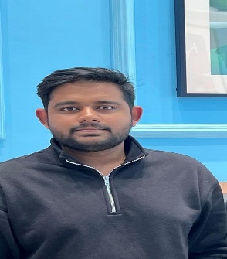
PHOTO
Aman Sinha | Analyst
asinha16@deloitte.com | Deloitte Touche Tohmatsu India LLP
Mobile: +91-9818497930
Location: Delhi
Professional Summary:
Aman, an Analyst with over 8+ months of experience in MySQL, and Python. He is located in Delhi, India, and brings valuable expertise to the team. Aman is known for his strong problem-solving abilities and demonstrates high motivation towards achieving goals.
Relevant skills:
ETL Tools: Python,Pyspark
Data base: SQL, MySql, SSMS
Other: Azure Databricks,Azure DataFactory
Education:
Bachelor Of Technology, VIT-Chennai (2023)
Certifications:
Azure Data Factory | Data Engineering on Cloud (Udemy)
AZ-900
Key Projects:
Unilever(E.D.I.T.H):
Developed Spark applications using Spark SQL in Databricks for data extraction, transformation, and aggregation across multiple file formats, facilitating comprehensive data analysis and transformation.
Proficient in data quality assessment utilizing Databricks and PySpark, collaborating with clients to enhance and maintain high data standards.
Designed and implemented efficient pipelines in Azure Data Factory using T-SQL and Spark SQL, ensuring seamless ETL processes for optimal data movement and transformation.
Demonstrated expertise in cost reduction through the implementation of automation scripts, resulting in substantial operational savings and streamlined processes.
Managed diverse data ingestion and extraction processes, optimizing the codebase to achieve faster and cost-effective data delivery.
Collaborated on complex problem-solving with cross-functional teams, ensuring the smooth execution of data processes and effective communication with data providers.
Maintained a delicate balance between speed and accuracy to ensure timely high-quality data delivery.
Integral part of the Unilever invoice team, overseeing the end-to-end verification and processing of incoming invoices, as well as managing the reception and processing of payments made by clients to the company.

